Slide 1

Wine Quality Prediction
Shubham Bhavsar
Unrestricted

Slide 2





Business Problem
A Wine producer/SME wants to have insights about the Wine samples that has been produced in his winery to improve the wine quality. And, to have a formulated approach to determine the wine quality rather than traditional approach to judge the Wine.

Slide 3
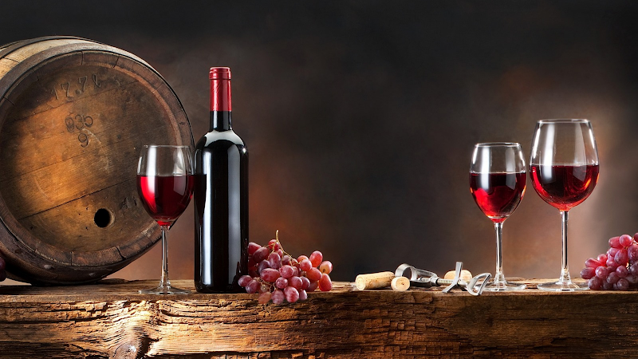

Overview
Data Collection
EDA
Data Processing
Model creation and Evaluation
Hyperparameter tuning
Wine Quality Predictor

Slide 4
Dataset
Variables | Details
pH | pH value
Density | Density of wine, g/cm3
Alcohol | % of alcohol by volume
Volatile acidity | Acetic acid, g/dm3 of wine
Citric Acid | Citric acid, g/dm3 of wine
Fixed Acidity | Fixed acidity of the sample
Residual Sugar | Remaining sugar after fermentation stops, g/dm3 of wine
Free Sulphur dioxide | Amount of free sulphur dioxide in sample
Chlorides | Sodium chloride, g/dm3 of wine
Total Sulphur dioxide | Total sulfite(free sulfite + bound), g/dm3 of wine
Sulphates | Potassium sulphate, g/dm3 of wine
Quality | Rating of the wine
1599 data samples | 12 variables

Slide 5
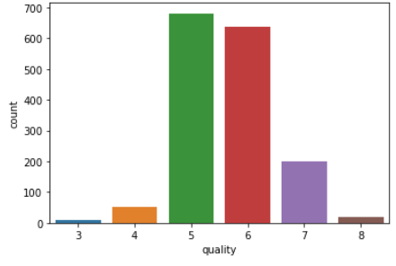
Quality

Slide 6
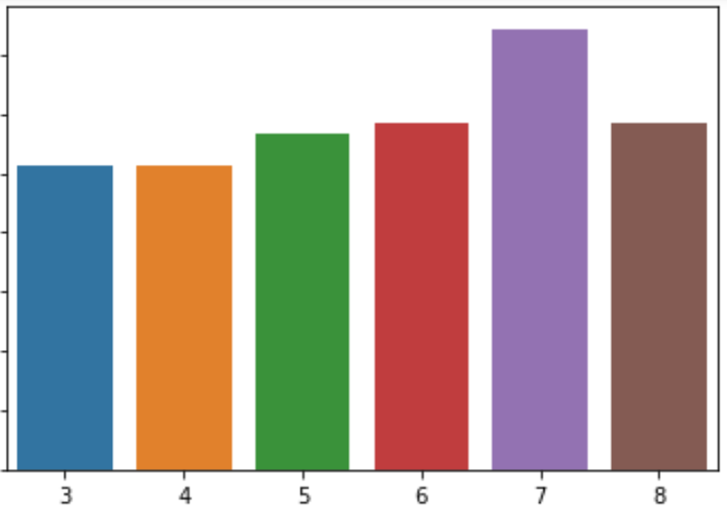
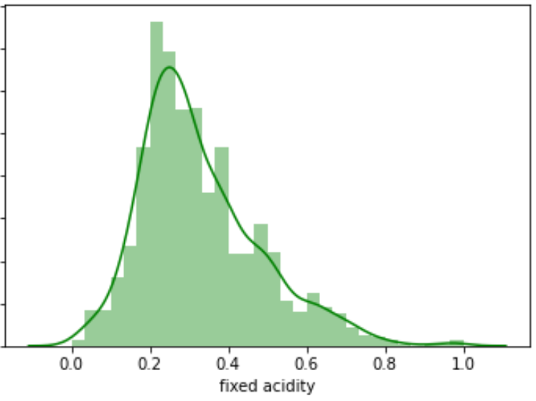
Fixed Acidity
Details | Value
Max | 15.9
Min | 4.6
Mean | 8.32
Standard Deviation | 1.74
Median | 7.9
1st quartile | 7.1
3rd quartile | 9.2
Skew | .98
Kurtosis | 1.13

Slide 7
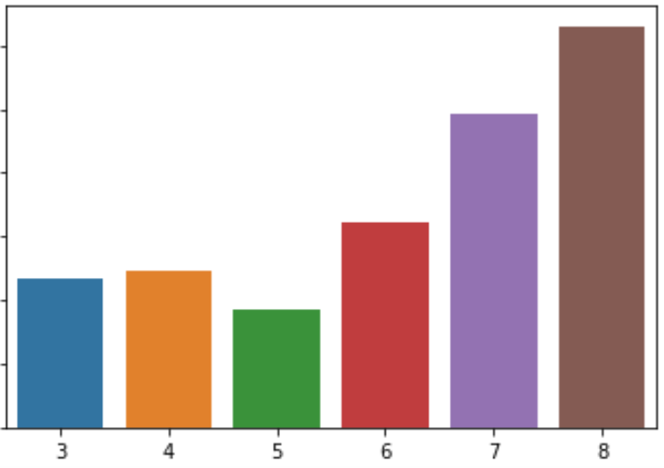
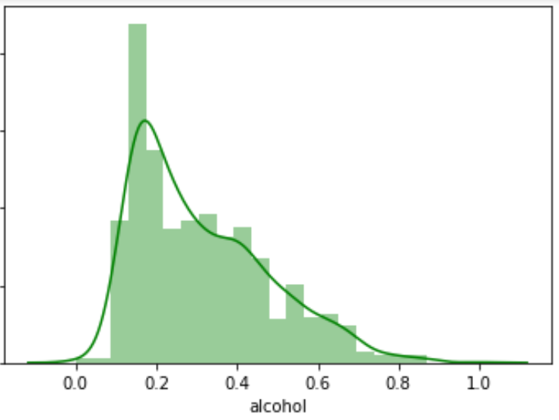
Alcohol
Details | Values
Max | 14.9
Min | 8.4
Mean | 10.423
Standard Deviation | 1.0657
Median | 10.2
1st quartile | 9.5
3rd quartile | 11.1
Skew | 0.861
Kurtosis | 0.2

Slide 8
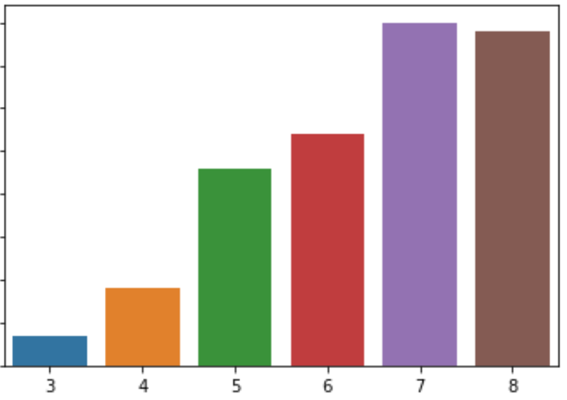
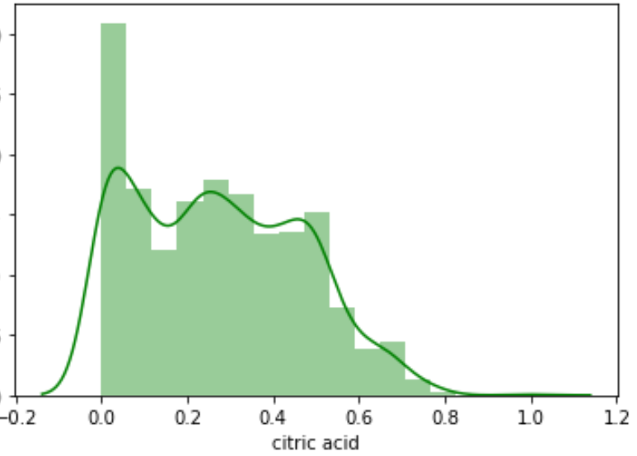
Citric Acid
Details | Values
Max | 1
Min | 0
Mean | 0.271
Standard Deviation | 0.195
Median | 0.26
1st quartile | 0.09
3rd quartile | 0.42
Skew | 0.318
Kurtosis | -0.789

Slide 9
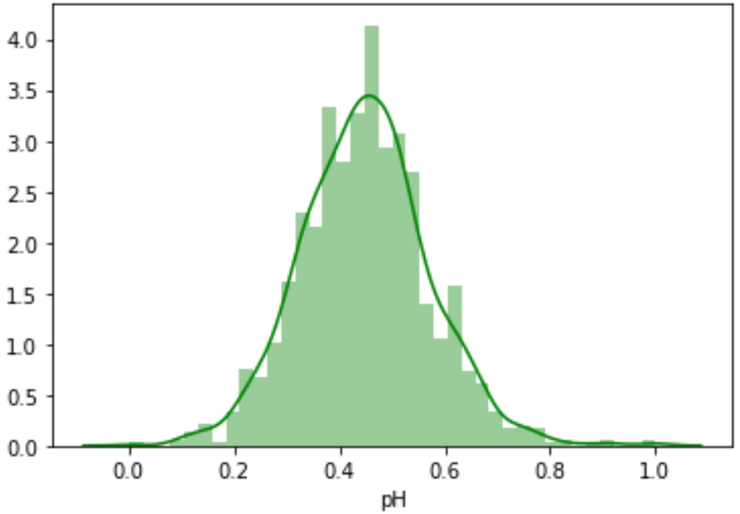
pH
Details | Value
Max | 4.01
Min | 2.74
Mean | 3.311
Standard Deviation | 0.154
Median | 3.31
1st quartile | 3.21
3rd quartile | 3.4
Skew | 0.19
Kurtosis | 0.81

Slide 10
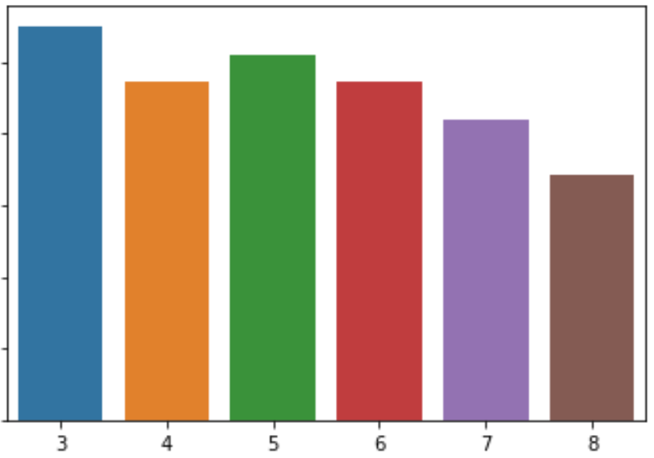
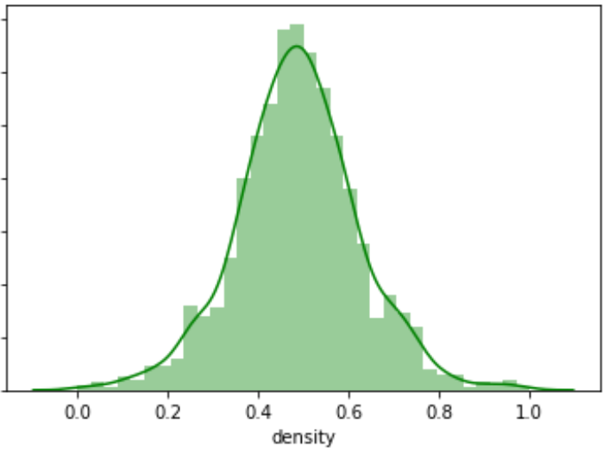
Density
Details | Values
Max | 1.00369
Min | 0.99007
Mean | .996747
Standard Deviation | 0.001887
Median | 0.99675
1st quartile | 0.9956
3rd quartile | 0.997835
Skew | 0.071
Kurtosis | 0.934

Slide 11
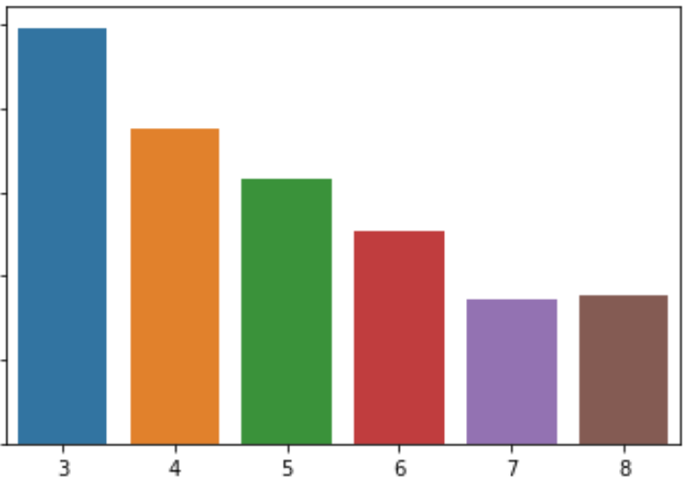
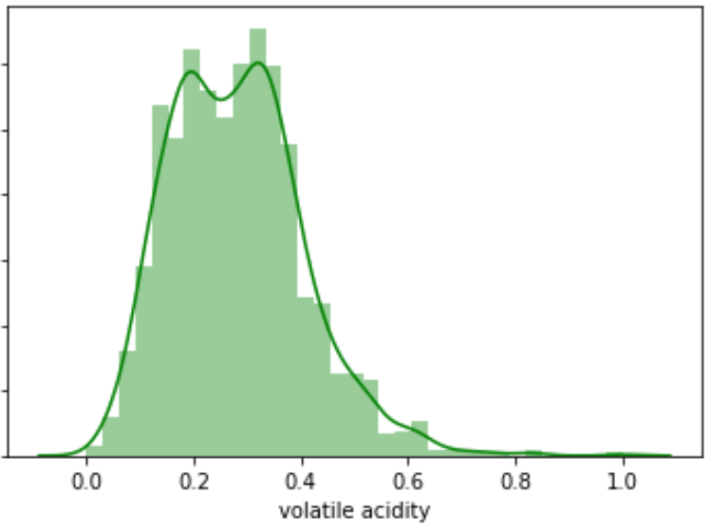
Volatile Acidity
Details | Values
Max | 1.58
Min | 0.12
Mean | 0.528
Standard Deviation | 0.179
Median | 0.52
1st quartile | 0.39
3rd quartile | 0.64
Skew | 0.672
Kurtosis | 1.226

Slide 12
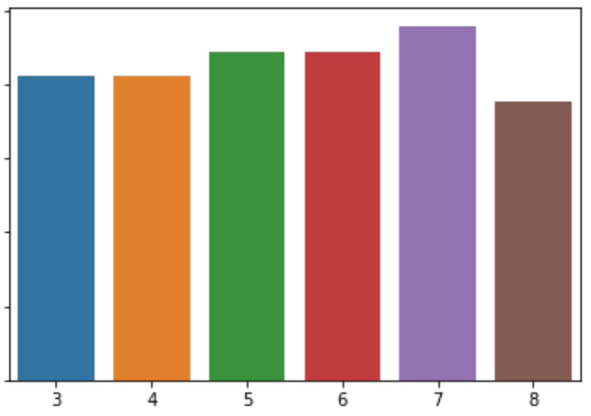
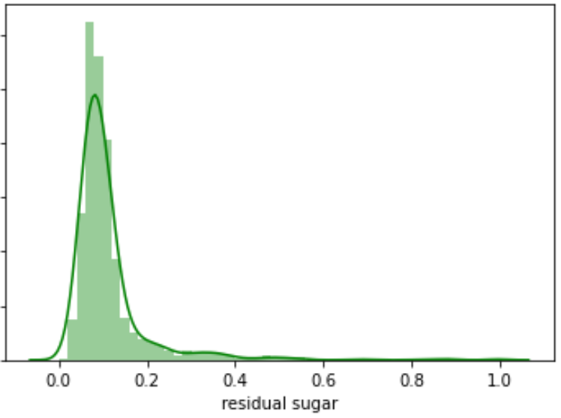
Residual Sugar
Details | Values
Max | 15.5
Min | 0.9
Mean | 2.539
Standard Deviation | 1.41
Median | 2.2
1st quartile | 1.9
3rd quartile | 2.6
Skew | 4.541
Kurtosis | 28.61

Slide 13
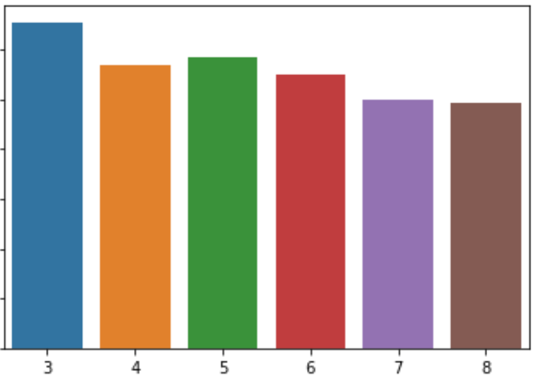
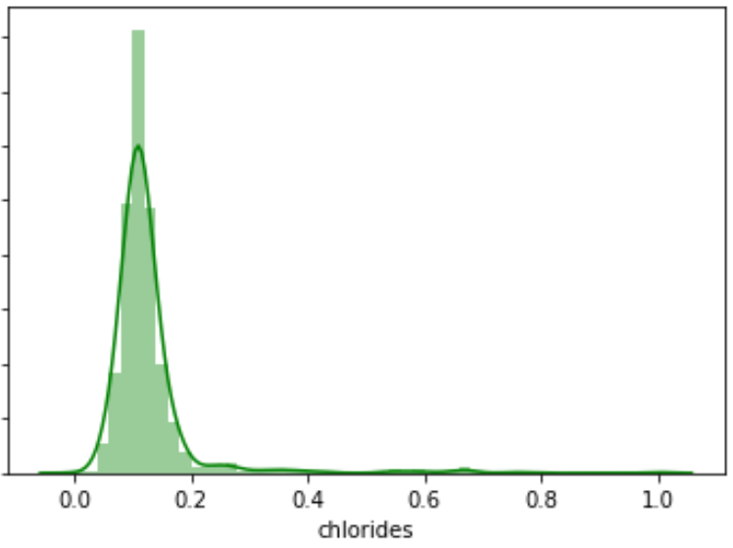
Chlorides
Details | Values
Max | 0.611
Min | 0.012
Mean | 0.087
Standard Deviation | 0.047
Median | 0.079
1st quartile | 0.07
3rd quartile | 0.09
Skew | 5.68
Kurtosis | 41.72

Slide 14
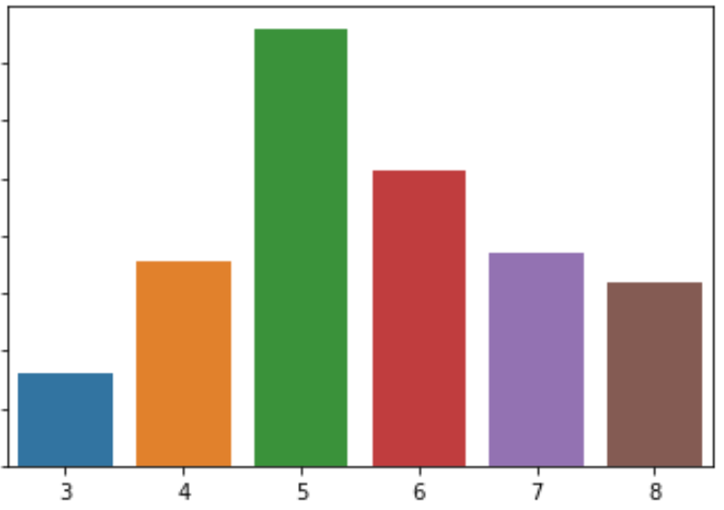
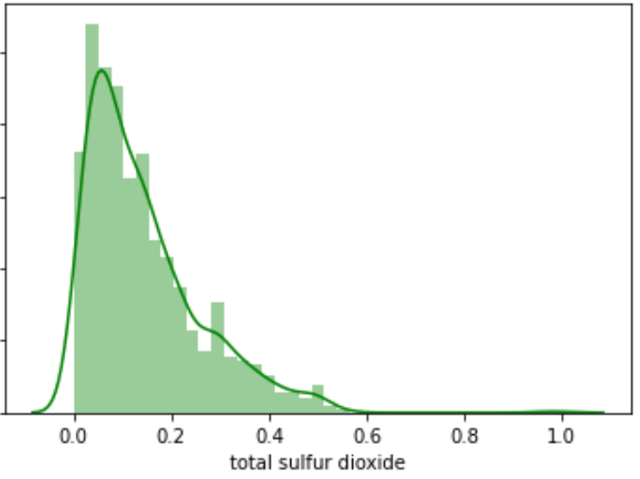
Total Sulphur Dioxide
Details | Values
Max | 6
Min | 289
Mean | 46.468
Standard Deviation | 32.895
Median | 38
1st quartile | 22
3rd quartile | 62
Skew | 1.516
Kurtosis | 3.81

Slide 15
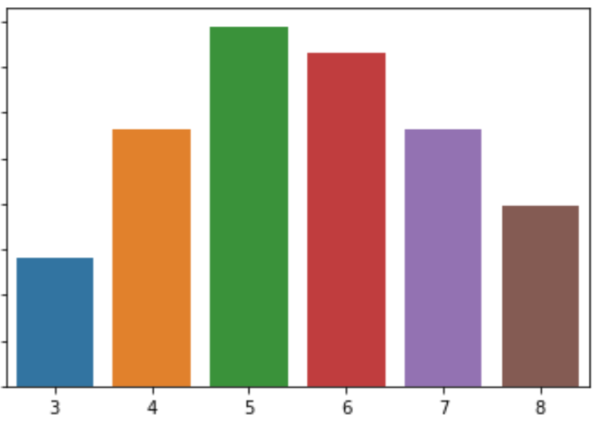
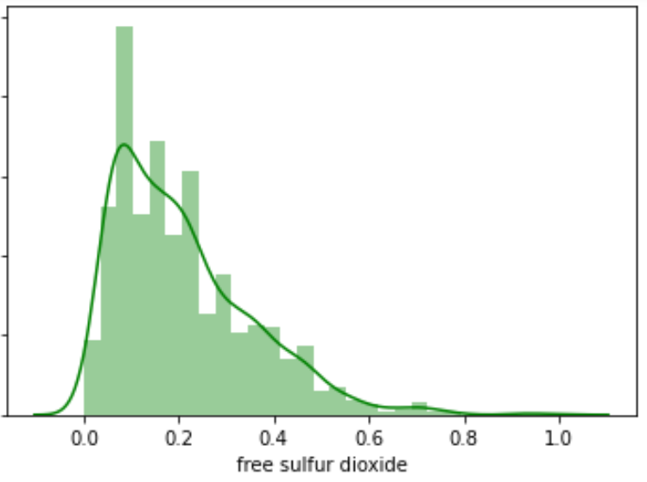
Free Sulphur Dioxide
Details | Values
Max | 72
Min | 1
Mean | 15.875
Standard Deviation | 10.46
Median | 14
1st quartile | 7
3rd quartile | 21
Skew | 1.251
Kurtosis | 2.023

Slide 16
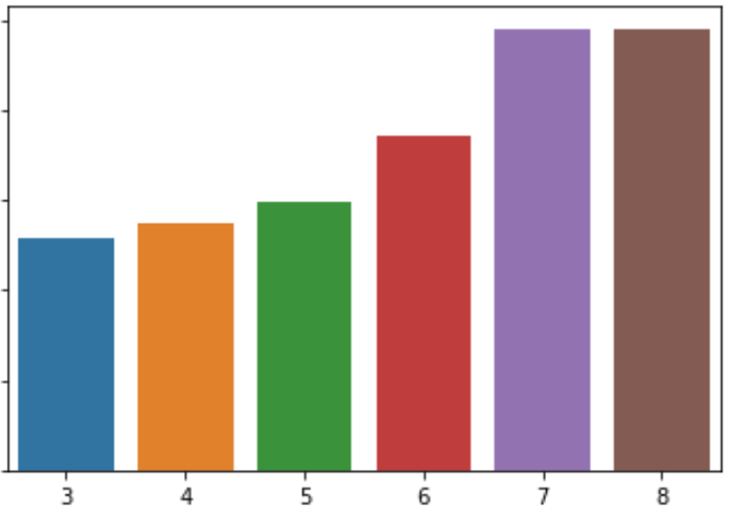
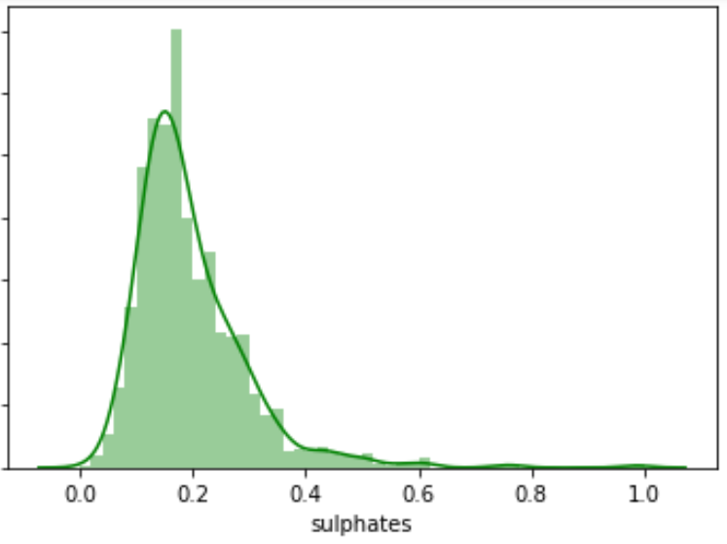
Sulphate
Details | Values
Max | 2
Min | 0.33
Mean | 0.658
Standard Deviation | 0.170
Median | 0.62
1st quartile | 0.55
3rd quartile | 0.73
Skew | 2.428
Kurtosis | 11.72

Slide 17
EDA summary
High quality wines characteristics
High alcohol content
Low volatile acidity
High in sulphates
High in citric acid

Slide 18
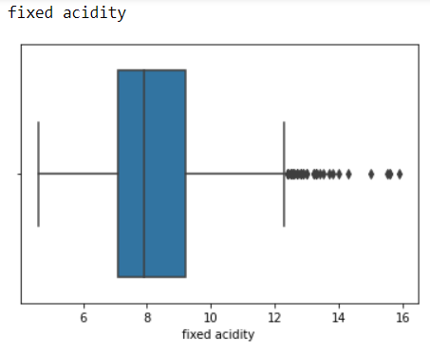
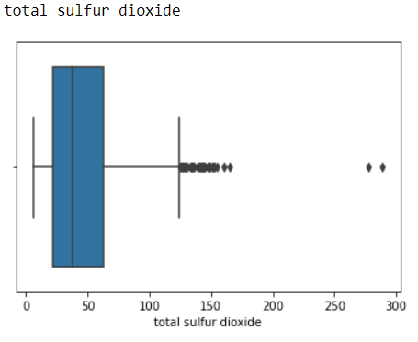
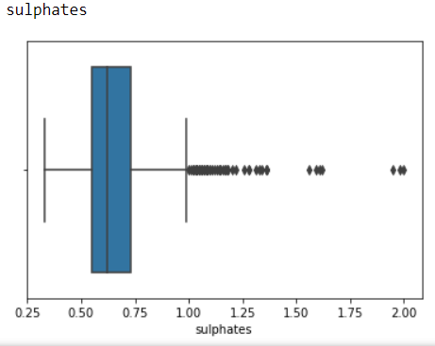
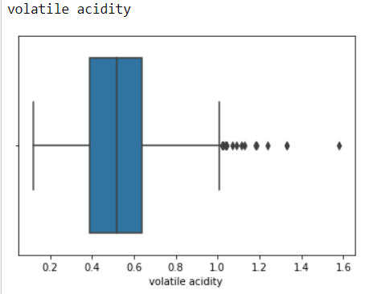
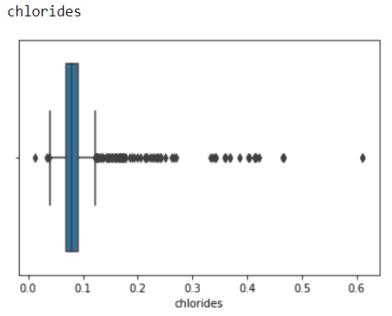
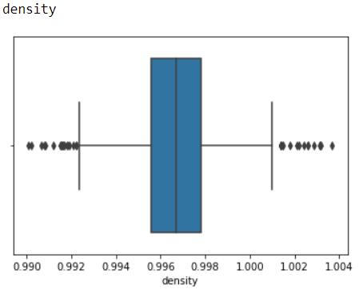
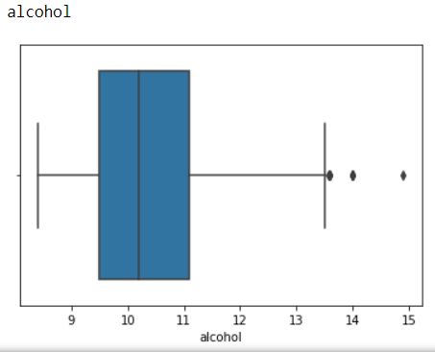
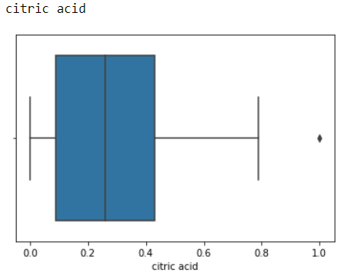
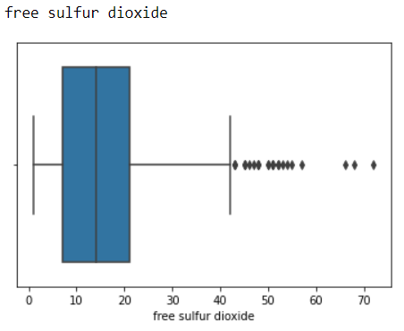
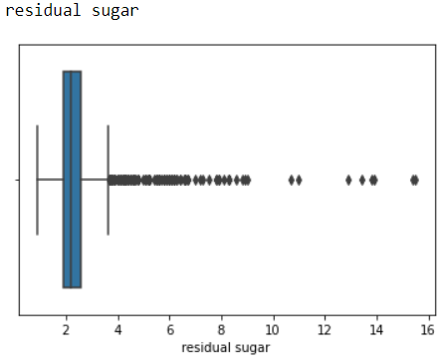
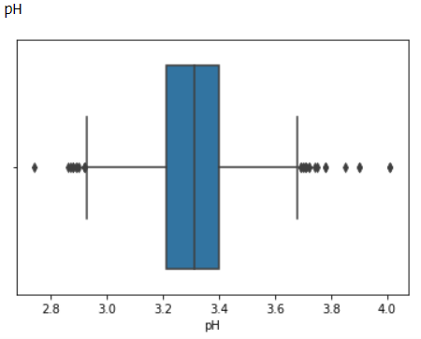
Outliers

Slide 19
Outlier Treatment
Outlier Detection
IQR Method
Remove the outlier
Delete the entries having outliers in any variable
Results in less data
Imputation at outlier
Replace the outlier with the median of the variable
Select median value depend on the quality

Slide 20
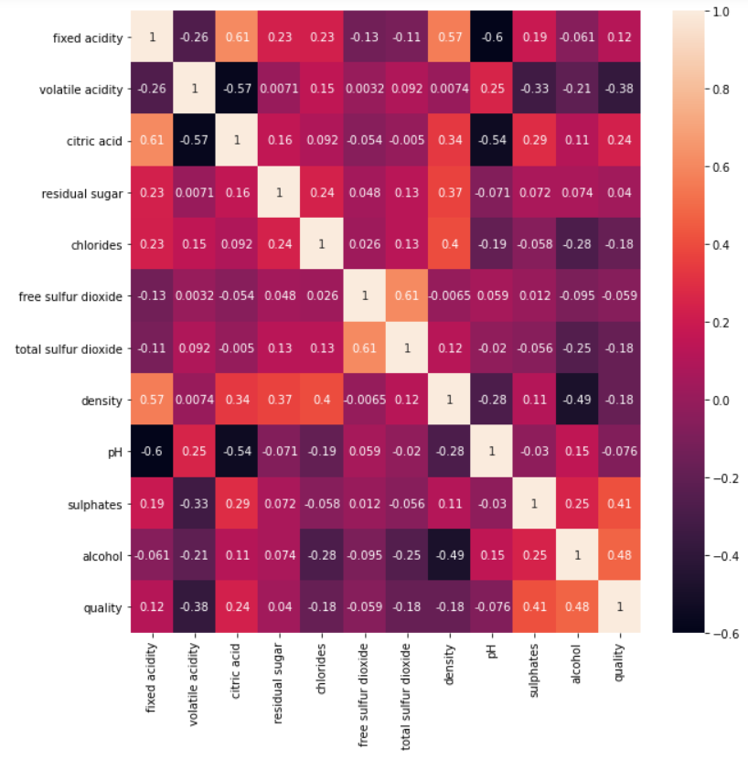
Correlation Analysis
Highest | Lowest
Alcohol | Free Sulphur Dioxide
Sulphates | pH
Volatile Acidity | Residual Sugar

Slide 21
Standardize the independent variables
Variables | Skewness | Kurtosis
fixed acidity | 0.58 | -0.2
volatile acidity | 0.32 | -0.32
citric acid | 0.28 | -0.88
residual sugar | 0.65 | 0.65
chlorides | 0.24 | 0.43
free sulfur dioxide | 0.80 | -0.14
total sulfur dioxide | 0.95 | 0.16
density | 0.02 | -0.02
pH | 0.04 | -0.2
sulphates | 0.64 | 0.04
alcohol | 0.74 | -0.3

Slide 22
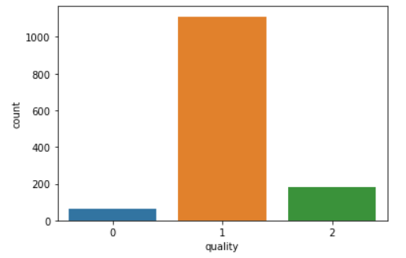
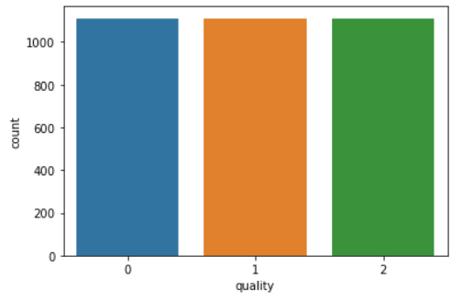
Target variable treatment
Convert the numerical rating into multiclass variable using label encoding
From 6 unique ratings, create 3 new classes by combining ratings
3 & 4 > Low (0)
5 & 6 > Medium (1)
7 & 8 > High (2)
Treat imbalance data using SMOTE and TOMEK technique

Slide 23
Dataset Split Strategy
Dataset
Train-Test split
Cross validation with stratified K-fold technique on Train dataset
Analyze performance on Test dataset using classification report, confusion matrix

Slide 24
Classifiers Performance
Algorithms | Accuracy
Decision Tree | 83.48
SVM | 86.48
KNN | 85.80
Naïve-Bayes | 66.60
Random Forest | 92.80
XGBoost | 93.86
Adaboost | 73.95
GradientBoost | 89.55
CATBoost | 93.89
LightGBM | 94.32

Slide 25
Hyperpameter Tuning
Algorithms | Accuracy %
XGBoost | 95.02
LightGBM | 94.74
CATBoost | 94.15
Randomized Search Cross Validation for selecting optimum parameters

Slide 26
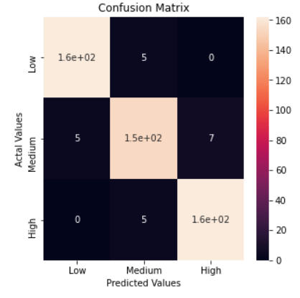
Confusion Matrix
Classes | Precision | Recall | F1 score
Low | 0.97 | 0.97 | 0.97
Medium | 0.94 | 0.93 | 0.93
High | 0.96 | 0.97 | 0.96

Slide 27
Real Time Prediction
Physicochemical Composition
HIGH
Medium
Low

Slide 28


Thank You

